Slide 1

Intro to Programming Final Presentation
By: Desmond Moran

Slide 2
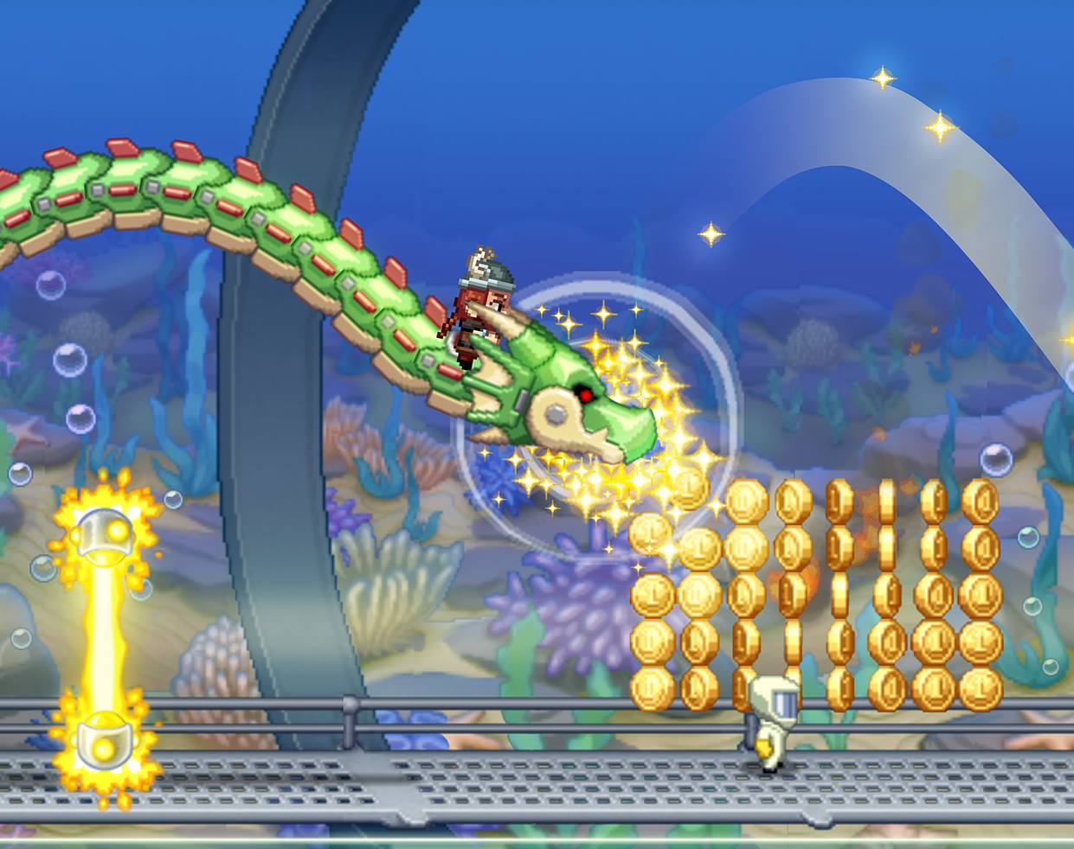
Goals
Make an endless runner plat former
player health/score
increasing speed
mobs that endlessly chase you
player upgrades/power ups

Slide 3
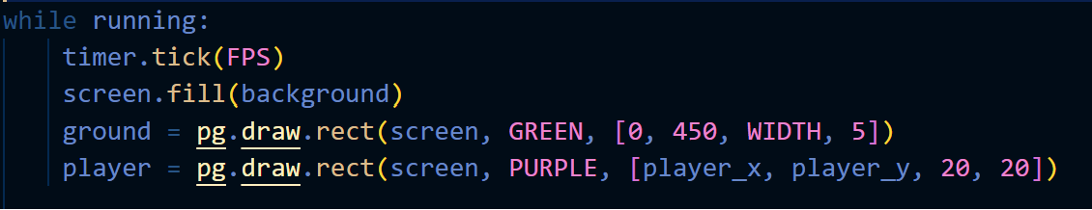
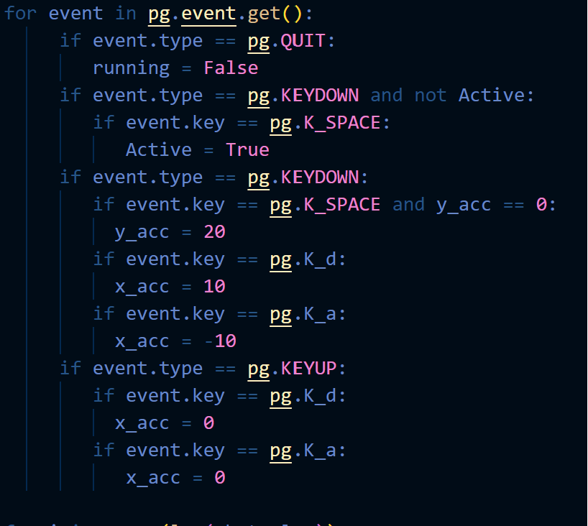
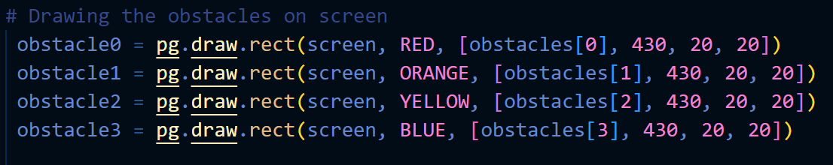
Main Code
Infinite While loop For Main game Engine
Character controls

Slide 4
Sources
https://www.youtube.com/watch?v=ZV8TNrwqG1Y
https://github.com/parthbyt/Infinite-Runner-Pygame
https://quirkycort.github.io/tutorials/20-Pygame-Zero-Basics/30-Ninja/40-jump.html

